Slide 1
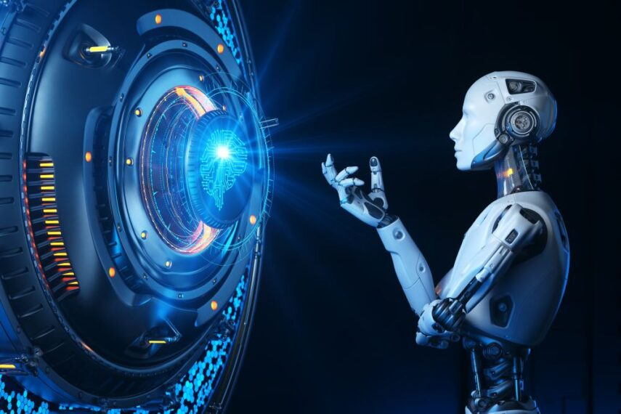
LiveFetch AI
Your Ai agent for Instance,Live information

Slide 2




Team Members:
M. Siva Harsha Vardhan
N. Ravi Kumar
G. Chandu
K. Yuva Rani
P. Anjali

Slide 3
Contents:
Problem Statement
Our Solution
Demo Flow
Tech Stack
Key Structure
Live Video
Impact & Use Cases
Future Scope

Slide 4
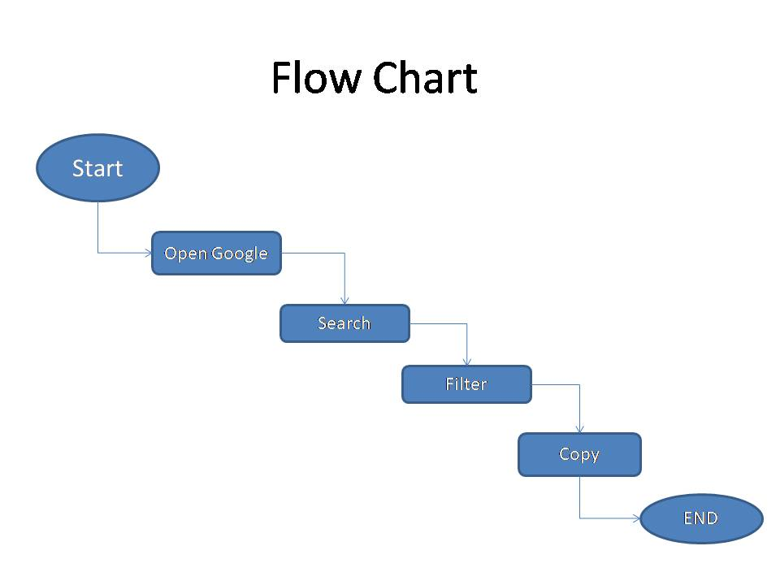
Problem Statement:
Current AI chatbots (ChatGPT, Gemini) → give outdated/static info.
Users must still open browsers, search, filter, copy data manually.
This wastes time and effort. We need an AI Agent that reduces daily steps and delivers fresh, real-time answers.

Slide 5
Our Solution:
An AI Agent that: Understands natural language instructions Uses a local LLM for planning Automates the browser to fetch live info Returns results in structured format (tables/lists)
Example :“Search laptops under ₹50,000 → Agent browses → Returns top 5 with prices.”
GivePromt
Get Solution

Slide 6
Demo Flow
User Input
AI Agent(LLM)
Browser Automation
Website
Data Extraction
Structured Output

Slide 7
Tech Stack:
Orchestration: Python / Node .JS Instruction
Parsing: Lang Chain + ollama (local LLM)Browser
Automation: Playwright / Selenium / Puppeteer
Output: JSON → Table/Chat UI Add tool logos (Python, Lang Chain, Playwright, etc.)

Slide 8
Key Structures:
Real-time, updated answers
Local execution = privacy + no cloud dependency
Simple natural language commands (no coding)Structured outputs (tables, lists, links)

Slide 9
Impact & Uses:
Students → research laptops, books, courses
Shoppers → product comparisons
Professionals → fetch latest stock/news
General users → save time, skip manual browsing

Slide 10
Future Scope:
Voice-based
Commands Multi-language
Support Deeper
integrations (forms, emails, job portals, etc.)

Slide 11



